Slide 1
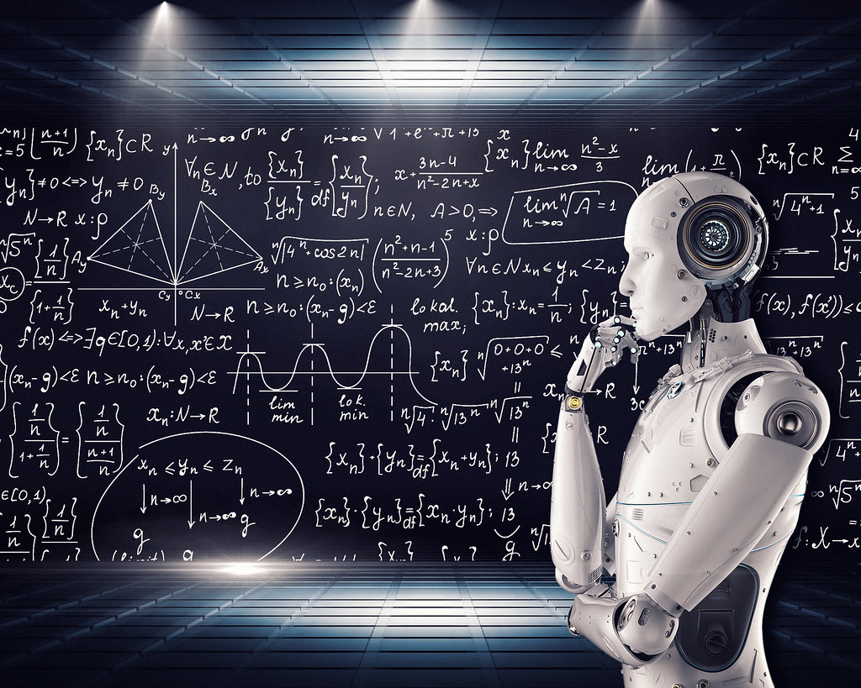

Navigating the Future: AI's Transformative Influence on the Travel Industry and Mitigating Travel Risks
Dr. John M. Rose
January 31, 2024

Slide 2

AI & Disruption
The theory of disruptive innovation, introduced by Harvard Business School professor Clayton Christensen in the late 1990s, explains how new technologies or business models can disrupt established industries or markets. Disruptive innovation occurs when a simpler, more affordable, or more convenient product or service enters the market, initially appealing to a niche or underserved segment.
Disruptive Technology/Innovation:
  New product or service, simpler, more affordable, or more convenient
  Initially serves a niche or underserved market
Sustaining Technology/Innovation:
  Improvements by established companies to existing products
  Target existing customer base
Disruption of Incumbents:
  Targets underserved segments, gains initial foothold
  Gradual improvement and expansion
  Poses a threat to established companies
Market Transformation:
  Potential to transform entire market
  Displaces established players, redefines industry dynamics
Innovator's Dilemma:
  Established companies hesitant to invest in disruptive tech
  May not align with existing business models
  Failure to adapt can lead to decline

Slide 3
AI & The Travel Industry
Personalized Customer Experiences:
  AI-driven recommendations based on preferences
  Real-time assistance through chatbots
Enhanced Travel Planning:
  Streamlined process with AI algorithms
  Virtual assistants for optimized itineraries
Dynamic Pricing and Revenue Management:
  AI-based dynamic pricing strategies
  Revenue optimization in real-time
Improved Operational Efficiency:
  Automation for booking and backend operations
  Robotic process automation for routine tasks
Predictive Maintenance for Transportation:
  AI predicts and addresses maintenance issues
  Proactive approach for enhanced safety
Efficient Customer Service:
  AI-driven chatbots for quick responses
  Natural language processing for human-like interactions
Data Analytics for Business Insights:
  AI analytics for informed decision-making
  Data-driven strategies for marketing and engagement
AR and VR Experiences:
  AI-enhanced AR/VR previews for destinations
  Revolutionary visualization of travel experiences

Slide 4
AI & TRM
AI promises to revolutionize travel risk management by providing more sophisticated tools for risk assessment, prediction, and response.
However, it also brings challenges related to data security, privacy, and ethical considerations that must be carefully addressed.
Organizations in the travel industry will likely need to adapt and integrate AI technologies to enhance the safety and security of travelers in the evolving landscape.

Slide 5
The Good
Enhanced Safety Measures:
AI for improved safety at all travel stages
Real-time analysis for threat identification
Predictive Analytics for Travel Risks:
Historical data, weather, geopolitical events
Informed decisions and preventive measures
Crisis Response and Management:
AI-powered chatbots for real-time guidance
Machine learning for effective crisis analysis
Customized Risk Assessments:
Personalized assessments based on traveler profiles
Targeted risk mitigation strategies
Security Screening and Biometrics:
  Facial recognition and biometrics for enhanced security
  Efficient and accurate threat identification
Automated Monitoring and Alerts:
  Continuous monitoring of news, social media, advisories
  Real-time automated alerts for potential threats
Data Security and Privacy Concerns:
  Ensuring security and privacy of traveler information
  Balancing data use for risk management and privacy protection
Assistance in Crisis Communication:
  AI-powered tools for efficient crisis communication
  Timely and accurate information dissemination

Slide 6
The Bad
Overreliance on Technology
Data Privacy Concerns
Bias in Algorithms
False Positives and Negatives
Lack of Human Touch in Crisis Response
Technical Malfunctions and Vulnerabilities
Job Displacement (is the bad????)
Unequal Access to Technology
Ethical Considerations in Decision-Making

Slide 7
The Scary
Security Breaches and Cyberattacks
Economic Impact
Algorithmic Discrimination
Inaccurate Risk Assessments
Loss of Human Connection
Dependency on a Single System or Provider
Privacy Invasion and Surveillance Concerns
Erosion of Cultural Authenticity

Slide 8

Embrace the Future
"The greatest danger in times of turbulence is not the turbulence itself, but to act with yesterday's logic." - Peter Drucker

Slide 9

Thank You
Dr. John M. Rose
Executive Doctor of Business Administration
Pepperdine Graziadio Business School
m: 443-852-5057
john.rose@pepperdine.edu
john.rose@altour.com

